Slide 2

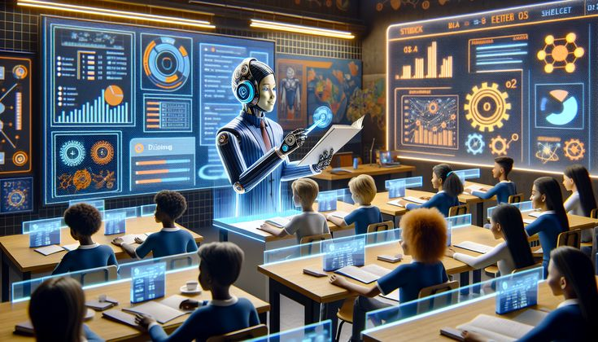
mini-project
Knowledge Builder ai agent
Presented By Morhaf Najjar - 5980
Presented for Dr. M. Aoude

Slide 3
mini-project
Knowledge Builder ai agent
Presented By Morhaf Najjar - 5980
Presented for Dr. M. Aoude

Slide 4
My time line
ACT | Time
A | 1h
B | 2h
C | 3h
D | 2h
E | 3h
F | 2h
G | 4h
A
model
Fri | Sat | Sun | Mon | Tue | Wed | Thu
project | work | Prepare Linux | Linux project | Pre PM | PM | ---
------- | -------- | ------- | 2h | 7h | 7h | 14h
B
Simple gui
C
Simple backend
D
Try connect
E
Improve gui
F
Improve data storing
Total = 30 hr
G
Improve backend

Slide 5
■ AON (Activity-On-Node) network
A
A
ACT | Description | Dep. | Time
A | Choose & download model | - | 1h
B | simple frontend | A | 2h
C | connect backend | B | 3h
D | try get response(fix error) | C | 2h
E | improve GUI | D | 3h
F | improve data collection | E | 2h
G | improve backend | F | 4h
H1 | GUI ppt | E | 1.5h
H2 | data collection ppt | F | 1.5h
H3 | Backend ppt | G | 2h
H4 | Entire ppt | G,H1,H2,H2,H3 | 4h
B
B
C
C
With
help
NO
help
D
D
H1
E
H1
H2
E
H2
F
F
H3
G
H3
G
H4
H4
Finish
Finish

Slide 6
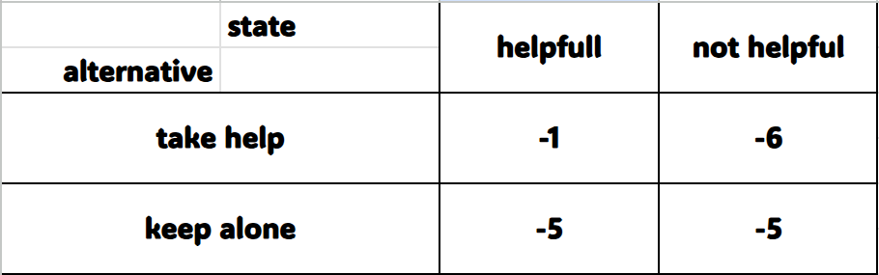
Make Decision for taking help Bayes’ Decision Rule
Time loss (hours)
P= ¾
P= ¼
E[timeloss (help)] = 0.25 * (-6) + 0.75 * (-1) = -2.25
E[timeloss (alone)] = 0.25 * (-5) + 0.75 * (-5) = -5
Taking help yields the min expected timeloss , continue . . .

Slide 7


Sensitivity Analysis forBayes’ Decision Rule
Crossover point
E[timeloss (help) ] = (-1)p - 6(1-p) = 5p-6
E[timeloss (alone)] = -5(1-p) + (-5)p = -5
help > alone ⬄ p > 1/5
Probability of
being helpful (p)
1
help
-5
Alone
-6
-10
So we get threshold p = 1/5 → I decide to take help

Slide 8
My time line
A
A
A
B
B
B
C
C
C
D
D
H4
D
E
H1
E
E
H2
F
F
F
G
H3
G
G
H4
H4
Finish
Finish
Finish

Slide 9
30 – 17 = 13h
ACT | Time
A | 1h
B | 2h
C | 3h
D | 2h
E | 3h
F | 2h
G | 4h
A
model
B
Simple gui
C
Simple backend
D
Try connect
Search and fix (3h)
E
Improve gui
+1
F
Improve data storing
+2
G
Improve backend
+2
T=17
Final organization (2h)
Training on ppt (2h)

Slide 10
LS=1
A
model
ACT | Time
A | 1h
B | 2h
C | 3h
D | 2h
E | 4h
F | 4h
G | 6h
O | 2h
T | 2h
LF=2
LS=2
B
Simple gui
LF=4
LS=4
C
Simple backend
LF=7
LS=7
D
Try connect
LF=9
LS=9
E
Improve gui
LF=13
LS=13
F
Improve data storing
LF=17
LS=17
G
Improve backend
LF=23
LS=23
O
Organize all
LF=25
LS=25
T
Training for ppt
LF=27
Finish
Time = 30 – 3 = 27 h

Slide 11


lesson

Slide 12
lesson

Slide 13
Topic1
Topic2
Topic3
Topic4
Topic5
Topic6
Topic7
Topic8
Topic9

Slide 14
Topic1
Topic2
Topic3
Topic4
Topic5
Topic6
Topic7
Topic8
Topic9

Slide 15
Topic5

Slide 16
Topic5

Slide 17
Subtopic1
Subtopic2
Subtopic3
Topic5
Subtopic4
Subtopic5
Subtopic6
Subtopic7
Subtopic8
Subtopic9

Slide 18
Topic
Topic
Topic
Lesson
Topic
Topic
Topic

Slide 19
Topic
Topic
Topic
Lesson
Topic
Topic
Topic

Slide 20
Subtopic
Topic
Subtopic
Subtopic
Topic
Subtopic
Topic
Lesson
Subtopic
Topic
Subtopic
Topic
Topic

Slide 21
Subtopic
Topic
Subtopic
Subtopic
Topic
Subtopic
Topic
Lesson
Subtopic
Topic
Subtopic
Topic
Topic

Slide 22
Subtopic
Topic
Subtopic
idea
Subtopic
Topic
idea
Subtopic
Topic
idea
Lesson
Subtopic
idea
Topic
Subtopic
idea
Topic
idea
Topic

Slide 23
Subtopic
Topic
Subtopic
idea
Subtopic
Topic
idea
Subtopic
Topic
idea
Lesson
Subtopic
idea
Topic
Subtopic
idea
Topic
idea
Topic

Slide 24
idea
Topic
idea
idea
Lesson
Subtopic
idea
idea
idea

Slide 25
idea
idea
idea
Lesson
Topic
Subtopic
idea
idea
idea

Slide 26
Lesson
Topic
Subtopic
idea
idea
idea
idea
idea
idea

Slide 27


Lesson
Full explanation
Full arrange quiz
Topic
Subtopic
idea
idea
idea
idea
idea
idea

Slide 28

YOUR WAY TO SUCCESS

Slide 29




IMPLEMENTAION SECTIONS
AI MODEL
GUI
DATABASE
BACKEND

Slide 30

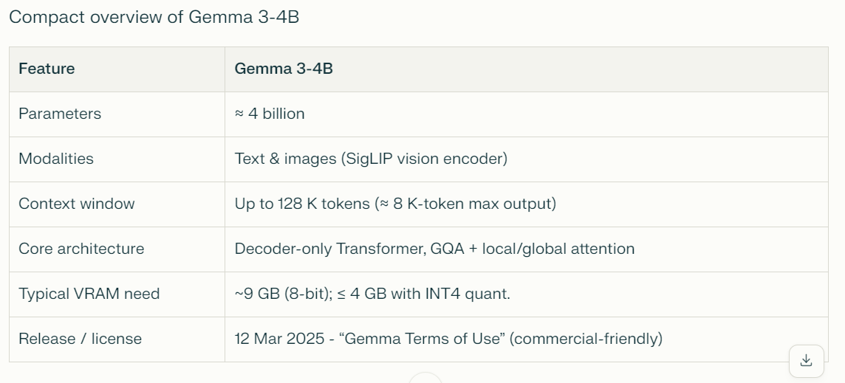
DATABASE
BACKEND
GUI
IMPLEMENTAION SECTIONS
AI MODEL

Slide 31
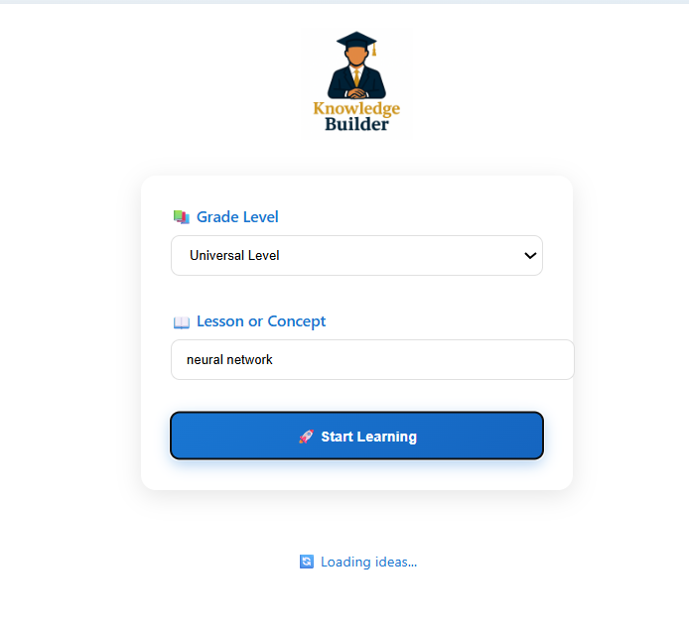
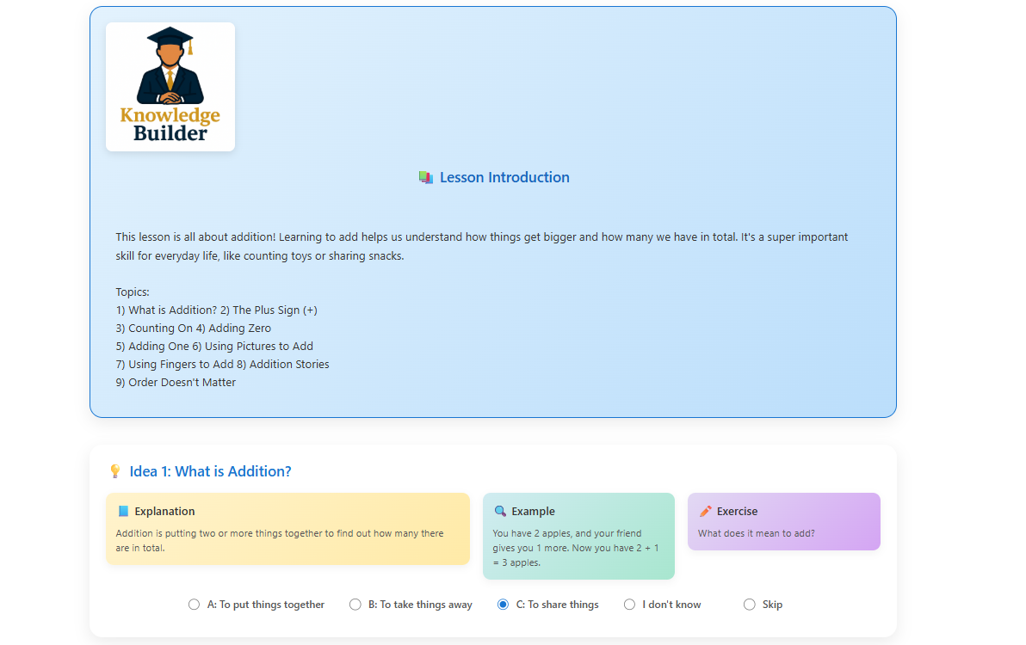
DATABASE
BACKEND
GUI
AI MODEL

Slide 32
DATABASE
BACKEND
GUI
AI MODEL

Slide 33
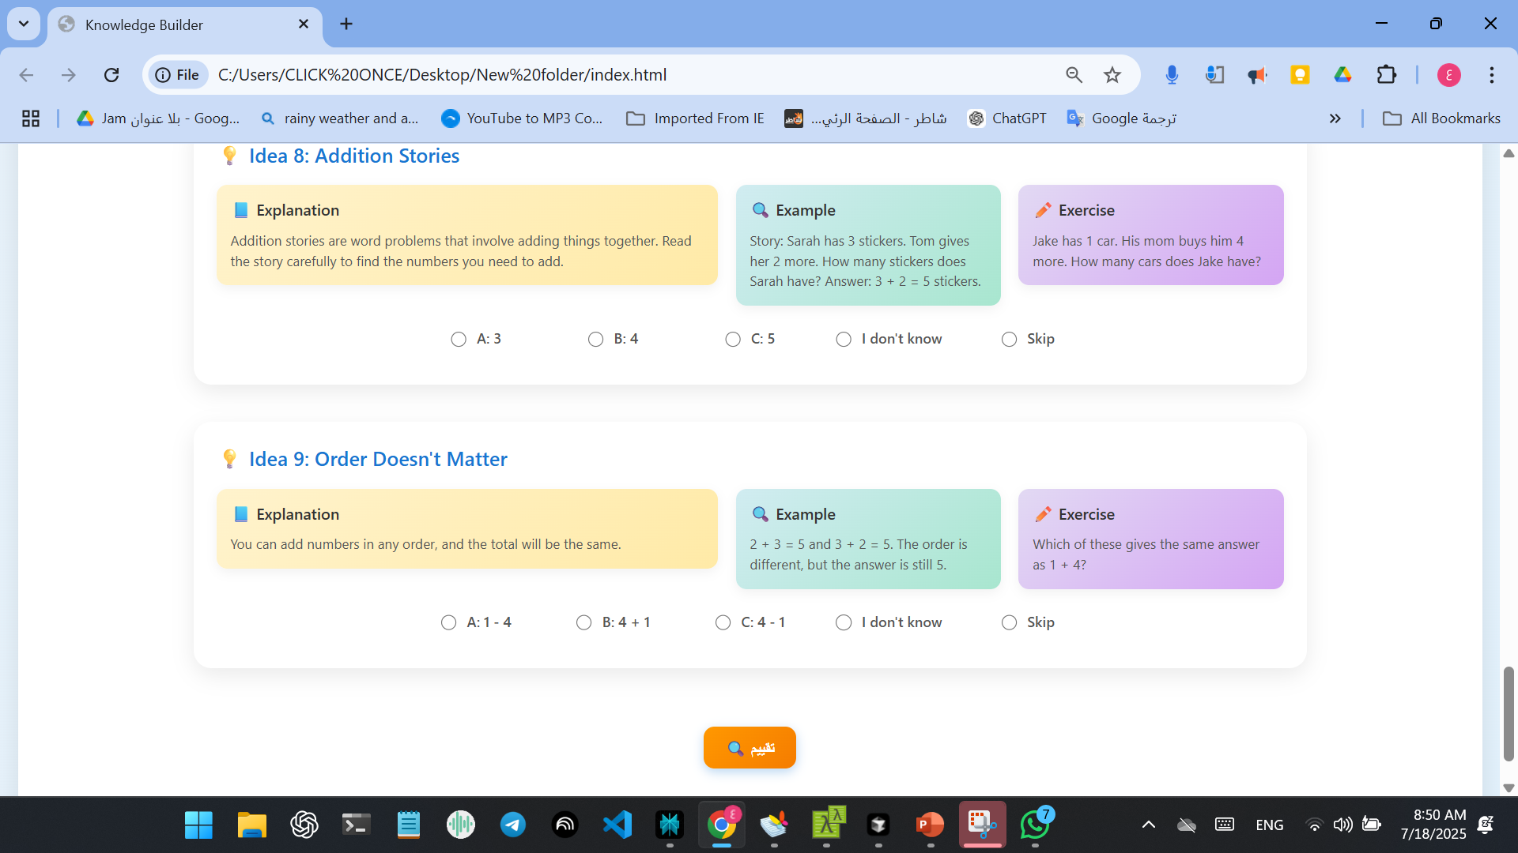
DATABASE
BACKEND
GUI

Slide 34
DATABASE
BACKEND
GUI
AI MODEL

Slide 35
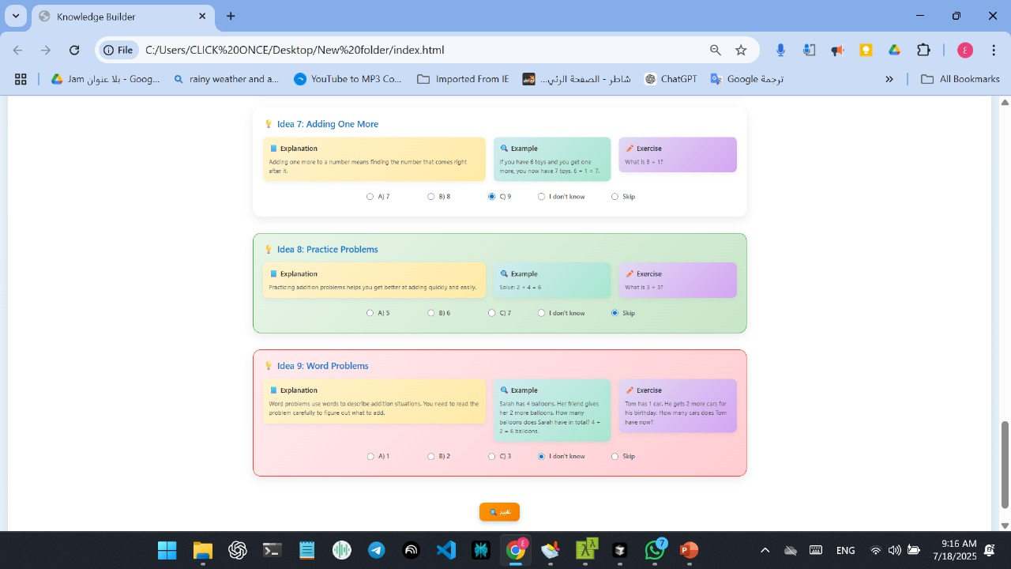
DATABASE
BACKEND
GUI

Slide 36
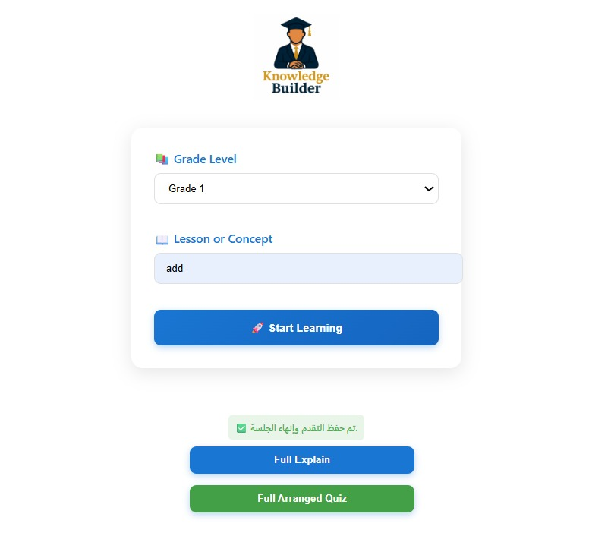
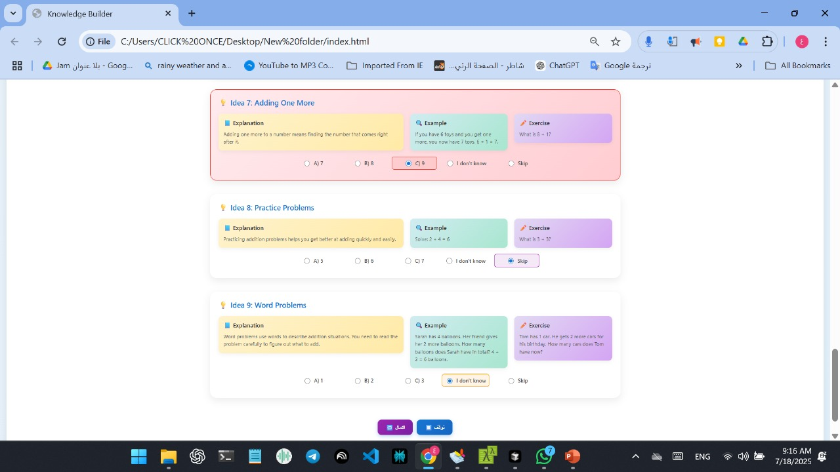
DATABASE
BACKEND
GUI
AI MODEL

Slide 37
DATABASE
BACKEND
GUI

Slide 38
DATABASE
BACKEND
GUI

Slide 39

DATABASE
GUI
DATABASE
BACKEND
AI MODEL
GUI

Slide 40
DATABASE
GUI
DATABASE
BACKEND
AI MODEL
GUI

Slide 41
DATABASE
GUI
BACKEND
DATABASE
AI MODEL

Slide 42
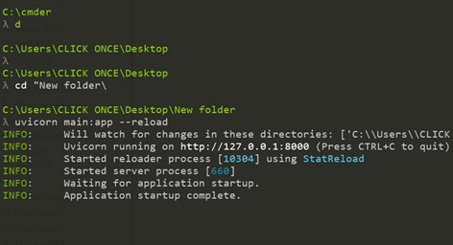
DATABASE
GUI
BACKEND
DATABASE
GUI
AI MODEL

Slide 43
DATABASE
GUI
BACKEND
DATABASE
GUI
AI MODEL

Slide 44
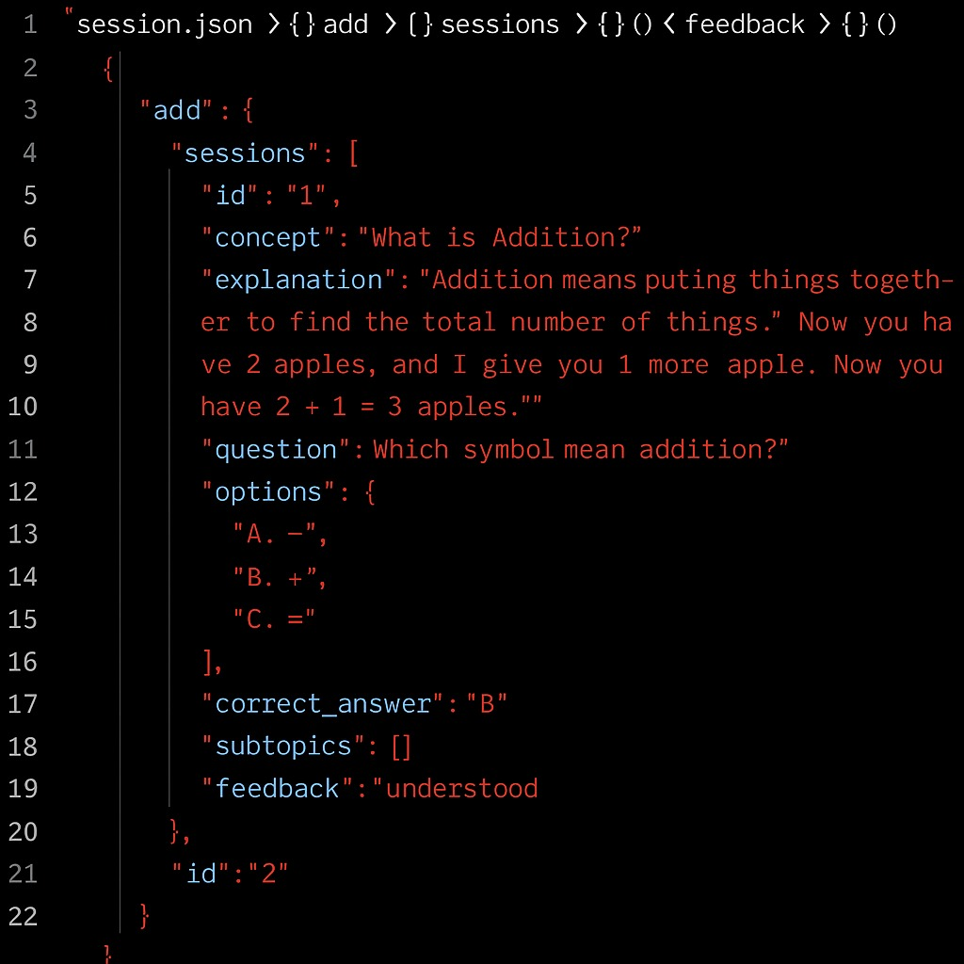
DATABASE
BACKEND

Slide 45
DATABASE
BACKEND

Slide 46
Future Improvement
DATABASE

Slide 47
Future Improvement

Slide 48
Future Improvement

Slide 49
Future Improvement
History
Account

Slide 50
Future Improvement
History
Account

Slide 51
Future Improvement
History
Account

Slide 52


Slide 53


